Slide 1
ON US Discount Sensitivity GBM model performance
January 2017

Slide 2
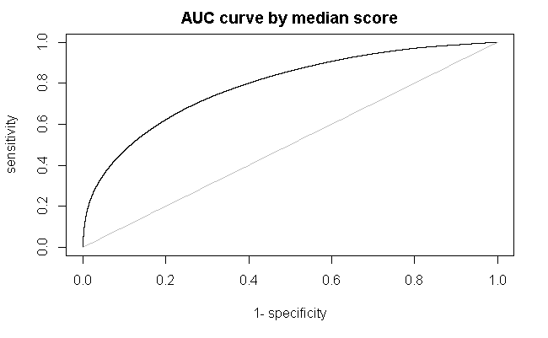
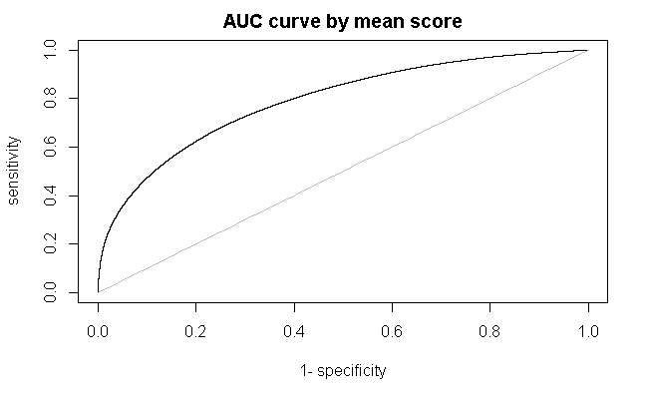
AUC Curve after ensemble
AUC by median ensemble 0.7894528
AUC by mean ensemble 0.7899846

Slide 3
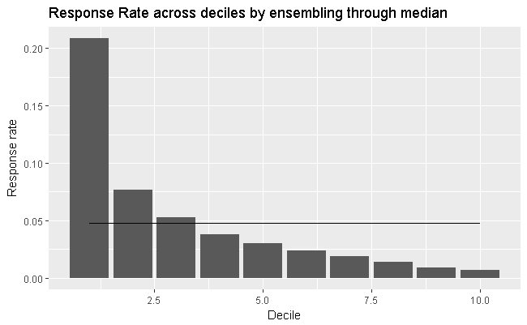
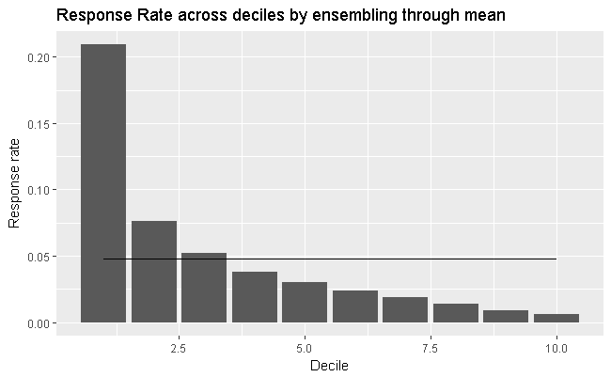
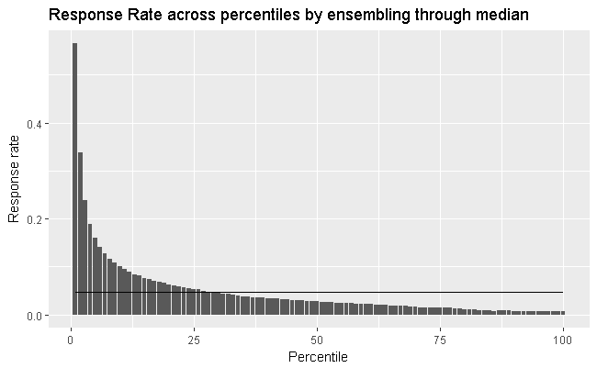

Response Rate Waterfall
Waterfall is maintained
Response rate by deciles/percentiles is higher than overall BAU response rate 0.1634871

Slide 4
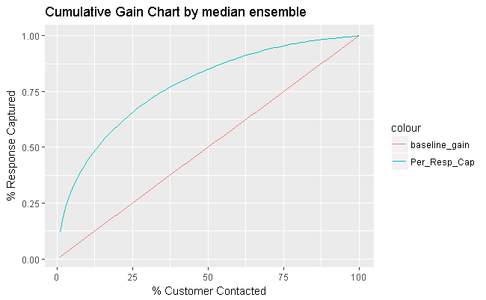
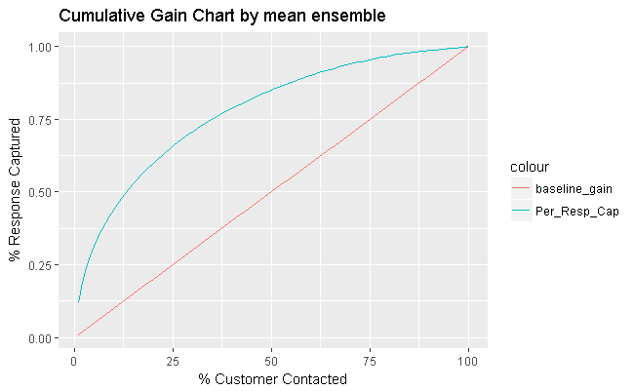
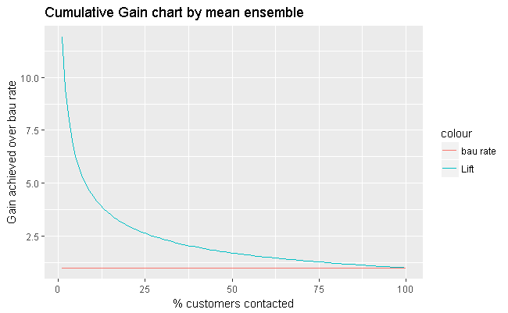
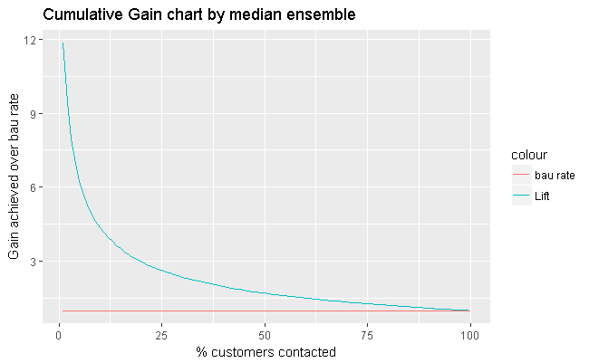
Cumulative Gain Chart and lift chart after ensemble
Overall BAU response rate 0.1634871

